Slide 1
Deconstructing a Paycheque

Slide 2
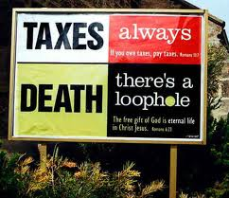
The Guarantees of Life
Taxes

Slide 3
What are taxes?
Tax is a compulsory contribution levied on persons, property, or businesses for the support of government for economic and social operations. In other words, it is money paid to a government to fund its programs and services.

Slide 4
Who’s responsible for this!
Canada uses a self-assessment system for tax collection. That means that each individual is responsible for having their taxes paid according to the Income Tax Act. It is up to you to calculate how much income tax you owe and what tax benefits you should be receiving.
YOU!

Slide 5
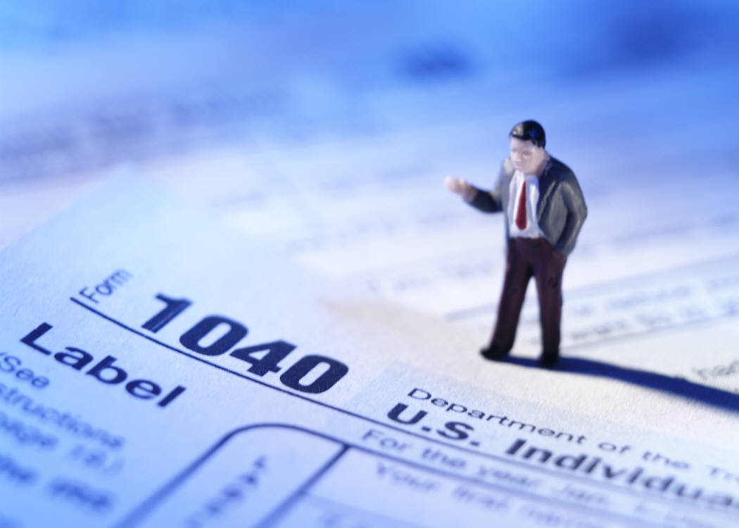
Important Information
Everyone’s tax return is different! Don’t assume that just because your neighbour got a refund that you will get a refund.
Know your benefits and where to look for extra benefits!
There are lots of places where you can get extra tax credits that you may not have thought of.
For example, if you moved for work or school you can deduct certain expenses from your net income thus saving you money!
You can deduct the cost of a monthly public transit pass from your net income!
You can claim up to a $500 benefit per child for any physical activity programs that you paid to register them in!

Slide 6
For the Lower Middle or Middle Class
If you make $45, 916 or less, you must pay 15%
Income x 0.15 = Taxes
Taxes and divide it by 12= Taxes you pay per month
If you make between $45, 916 and $91, 831 you must pay 20.5%
Income x 0.205= Taxes
Taxes and divide it by 12= Taxes you pay per month

Slide 7
For The Richer Half
If you make between $91,831 – $142,353 you must pay 26%
Income x 0.26 = Taxes
Taxes and divide it by 12= Taxes you pay per month
If you make $142,353 – $202,800, you must pay 29%
Income x 0.29 = Taxes
Taxes and divide it by 12= Taxes you pay per month
If you make more than $202,800 you must pay 33%

Slide 8
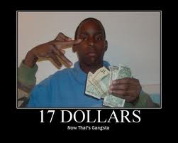
Why is my paycheck so low?
Your employer makes deductions from your salary or wages.
The most common ones are Canada Pension Plan (CPP), Employment Insurance Premiums (EI), and Income Tax.
Once you turn 18 and until you turn 70 you have to make CPP contributions based on your income.
EI contributions are based on a percentage of your pay and may change year to year.

Slide 9
Do you know these words? What do they mean?
Deduction
Gross pay
Net pay
Pay period
Pay stub
Pension
Salary
Wage

Slide 11
Adding up the benefits
Benefits may include:
■ Paid vacation days
■ Paid sick days
■ Health, dental, and eye care insurance
■ Life insurance
■ Disability insurance
■ Pension plan
■ Registered retirement savings plan
■ Parental leave
■ Stock purchase plan
■ Employee assistance plans
■ Employee fitness programs
■ Employee discounts

Slide 13
From Red to Black
Dealing with Debt and Credit

Slide 14
What is Debt?
An amount owed to a person or organization for funds borrowed. Debt can be represented by a loan note, bond, mortgage or other form stating repayment terms and, if applicable, interest requirements. These different forms all imply intent to pay back an amount owed by a specific date, which is set forth in the repayment terms.

Slide 15
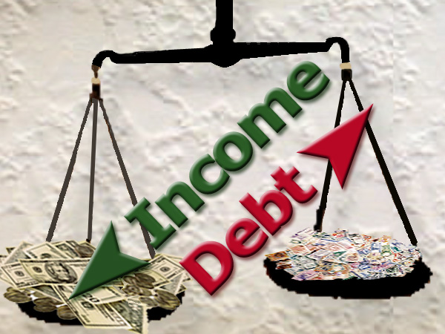
Debt a “Dirty” Word?
Not all debt is terrible, but debt can add up fast! High interest rates and making minimum payments you can get in over your head, making it very hard for you to get out.
Check out how much making minimum payments will cost you!
Check out how much faster your debt will grow then your savings.

Slide 16
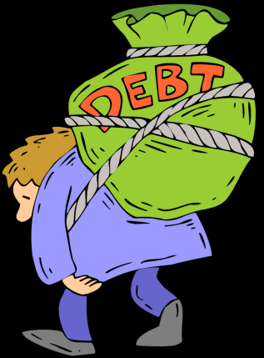
Controlling your Debt
People are loaded with credit-card debt.
Some debt is good.
Borrowing for a home or college usually makes sense. Just make sure you don't borrow more than you can afford to pay back, and shop around for the best rates.
Some debt is bad.
Don't use a credit card to pay for things you consume quickly, or if you can't afford to pay off your monthly bill in full in a month or two.
Get a handle on your spending.
Write down everything you spend for a month, cut back on things you don't need, and start saving the money left over.

Slide 17
Controlling your Debt
Pay off your highest-rate debts first.
The key to getting out of debt efficiently is first to pay down the balances of loans or credit cards that charge the most interest while paying at least the minimum due on all your other debt.
Don't fall into the minimum trap.
If you just pay the minimum due on credit-card bills, you'll barely cover the interest you owe. It will take you years to pay off your balance, and potentially you'll end up spending thousands of dollars more than the original amount you charged.
Watch where you borrow.
It may be convenient to borrow against your home but it can be dangerous. You could lose your home.

Slide 18
Controlling your Debt
Expect the unexpected.
Build a cash cushion worth three months to six months of living expenses in case of an emergency.
Don't be so quick to pay down your mortgage.
Don't pour all your cash into paying off a mortgage if you have other debt. Mortgages tend to have lower interest rates than other debts.
Get help as soon as you need it.
If you have more debt than you can manage, get help before your debt breaks your back. There are reputable debt counseling agencies that may be able to consolidate your debt and assist you.

Slide 19
The 4 C’s of Credit
Character – Reputation and history
Capital – net worth
Capacity- ability to repay credit (income v. expenses)
Collateral- what can be used to secure the loan?

Slide 20
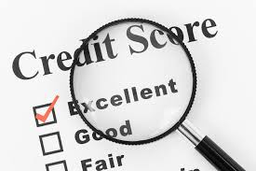
Credit Bureau and Credit Rating
Credit report: a detailed report of your credit history and is kept by at least one of Canada's credit-reporting agencies
You can request this for free
Credit score: an up-to-date rating of your financial health. It shows lenders the level of risk if they lend you money.

Slide 21
How to improve credit score
Always pay your bills on time
Pay in full by the due date
Try to pay debts as quickly as possible
Don’t go over your credit card limit
Reduce the number of credit applications you make
Make sure you have a credit history

Slide 22
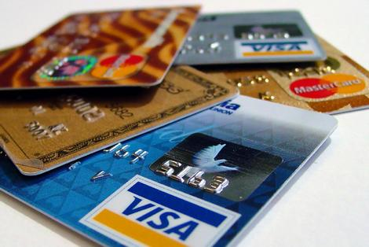
Credit Cards
Used wisely, a credit card can be a very convenient way to shop. As a bonus, it allows you to make purchases with nearly a month to pay for them before finance charges kick in.
But buyers beware. Those little plastic cards can get you into trouble. It's easy to overspend. Minimum payments are low. The debt can creep up on you slowly.
So before you put another piece of plastic in your wallet, make sure you know what you’re really signing up for - and, what it's really going to cost you.

Slide 23
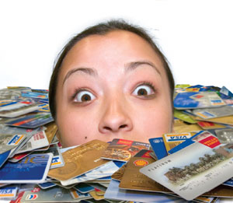
Credit Cards
Here are some of the top things you need to know about your card:
Annual fee. Some cards come with a flat, yearly charge that's like a membership fee. Others have no yearly fee.
Balance due. This is the amount you must pay each month on time to avoid interest charges. It can include any unpaid balance you owe from a previous bill, as well as any new charges, interest, late fees or annual fees.
Credit limit. This is the amount you can borrow using your card. The lender cannot change this limit without letting you know.

Slide 24
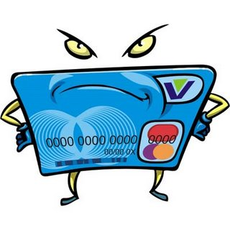
Credit Cards
Finance charges. If you don't pay off your balance due on time, these charges can include late fees plus interest. You will likely pay a higher rate of interest on any cash you borrow using your card and a lower rate on money you borrow for store purchases.
Grace period. This is the time you have to pay off the balance you owe each month before you will have to pay interest. In most cases, the grace period starts on the billing date and ends a certain number of days after. If you pay off your balance in full each month, your card company must give you a grace period of at least 21days.

Slide 25
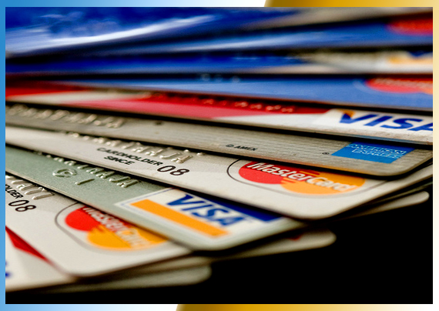
Credit Cards
Annual percentage rate (APR). This is the yearly percentage rate of the finance charge.
Introductory rate. This is a special offer that gives you a temporary, lower APR. In most cases, the offer lasts for about six months. Then it goes up to the normal rate for your type of card. Your card company must tell you in advance when interest rates are going to increase - even if the information is part of your contract.

Slide 26
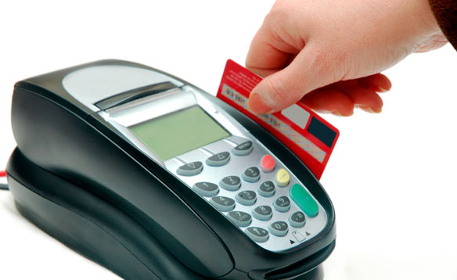
Credit Cards
Get it on Credit Video
Princess Video:
http://www.slice.ca/princess/video/episode/princess-katelyn/video.html?v=64223811799

Slide 27
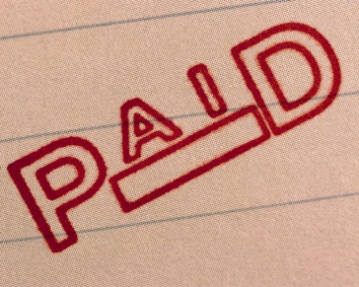
Choosing a Card
Learn about your options. Credit cards come in all shapes and sizes.
Ask yourself: how will I use this card? For example, if you will pay off what you owe in full each month, you will not benefit as much from a lower interest rate. If you will carry forward a balance from month to month, then the opposite is true.
I will pay off my balance in full, most of the time. | Reward cards, house cards or travel and entertainment cards
I will likely carry a balance from month to month. | A bank card with the lowest interest rate you can find.

Slide 28
Choosing a Card
How long is the grace period? The grace period is the time you have to pay off the balance you owe each month before you will have to pay interest.
What's the annual percentage rate (APR)? This is the interest rate you will pay on any unpaid balance after the grace period. The higher the APR, the more it will cost you to use the credit card.
What are the fees? You should know the amount of any fees for your card and when they apply. The most common types of fees include: annual fee, late fee (usually $15-$30) and over-the-limit fee (around $20-$25).

Slide 29
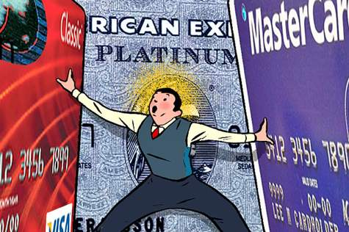
Choosing a Card
Compare any extra features the card offers. These include loyalty points, cash back and more. Many cards also offer extras like insurance.

Slide 30
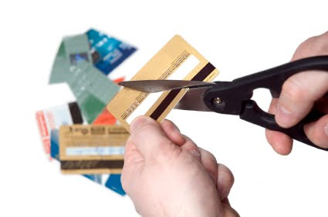
The Bottom Line
Do not buy things you can not afford to pay off this month!!!
https://vimeo.com/41152287

