Slide 1
Financial Planning
Saving for the future

Slide 2
Savings
What are some ways to help save money?
Multiple dedicated bank accounts
Automatic transfers to savings accounts
Keep a budget
Prioritize spending habits
Have SMART goals
Keep credit card and debt balances low

Slide 3
Compound Interest
Compound Interest video link:
https://www.youtube.com/watch?v=wf91rEGw88Q
Interest is added to the principal so you gain interest on the interest.
Money makes money…

Slide 4
(savings per month)

Slide 5
$200 a month
http://www.businessinsider.com/saving-at-25-vs-saving-at-35-2014-3

Slide 6
http://www.businessinsider.com/compound-interest-retirement-funds-2014-3

Slide 7
Financing your dreams
Saving for short, medium, and long term goals
Saving for Post Secondary Education
Saving for Retirement

Slide 8
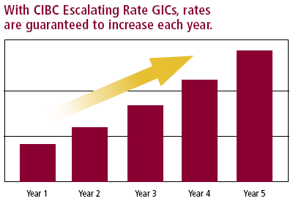
Saving for Short Term Goals
Guaranteed Investment Certificates (GICs) are secure investments that guarantee to preserve your principal.
Your investment earns interest, at either a fixed or a variable rate, or based on a pre-determined formula.
GICs often form the foundation of a well-balanced portfolio.
Benefits
Security and safety—both your original investment and interest payments are guaranteed
Flexible investment terms—ranging from one day to five years, and seven years and ten years

Slide 9
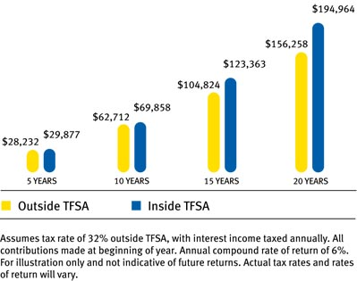
TFSA (Tax Free Savings Account)
Regardless of what you're saving for – a new car, an emergency fund, or a new home – you can use a TFSA to grow your savings faster by sheltering your investment earnings and withdrawals from tax.
Investment income in a TFSA—whether you’re earning interest, dividends or capital gains—are not taxed, even when withdrawn.
This tax-free compound growth means that your money grows more quickly inside a TFSA than in a taxable account

Slide 10
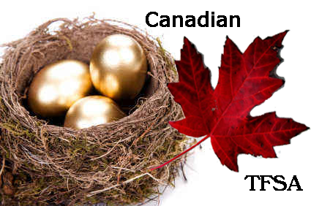
You can withdraw funds from your TFSA whenever you want (depending on what you've invested in), and use the funds for multiple purposes.
This makes a TFSA ideal for both your short and long-term investment goals.
For example, you could save to purchase a new car, renovate your home, buy a new home, start a small business, take a vacation, build an emergency fund, grow your retirement nest egg and more.

Slide 11
Saving for Post Secondary Education
Cost of Post Secondary Education
$4,800 - Tuition
$600 - Compulsory Fees
$6,700 - Residence & Meals
$1,000 - Textbooks & Supplies
$2,500 - Personal Expenses
$15,600 - Total Cost per year
(BC Average)
2015
$ 45,900 - 4 year program without residence
$77,500 - 4 year program with residence
Student Debt
25% of students take out student loans
Average student debt for those students who take out students loans - $27,000 (4 year degree)

Slide 12
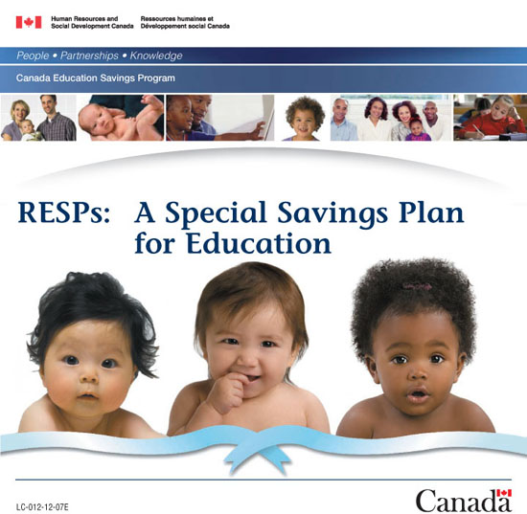
Registered Education Savings Plan
RESP is an investment vehicle used by parents to save for their children's post-secondary education in Canada.
Two advantages of RESPs
Advantage #1 - Access to the Canada Education Savings Grant (CESG)
the government of Canada contributes 20% of the first $2,500 in annual contributions made to an RESP

Slide 13
Advantage #2 A source of tax-deferred income.
RESP contributions have already been taxed at the contributor's tax rate, while the investment growth (and CESG) is taxed on withdrawal at the recipient's tax rate.
An RESP recipient is typically a post-secondary student; these individuals generally pay little or no federal income tax, owing to tuition and education tax credits.
Thus, with the tax-free principal contribution available for withdrawal, CESG, and nearly-tax-free interest, the student will have a good source of income to fund his or her post-secondary education.

Slide 14
Student Lines of Credit
You're a student—or the parent of a student—and need an easy and flexible way to borrow money for tuition, books and more, the Credit Line for Students can help.
Unlike a traditional student loan, where you borrow all the money up-front, the Credit Line for Students lets you access a specific amount of money each year. You can use all or a portion of the funds in the credit line at any time—and you can reuse it as soon as you repay what you've borrowed.
This makes it easier to manage your debt and can even help reduce your interest costs.
Plus, it costs nothing to set it up!

Slide 15
Advantages of Student Credit Lines
Flexible limits
Lower interest rate
No annual fee
Easy to access
Easy to repay - As long as you're in school part–time, you only have to pay the interest owing each month. After graduating, you have up to 12 months before you have to start repaying the principal you've borrowed. The bank will set up a fixed payment schedule to help you repay your loan.
Use your credit again and again
Optional Loan Protector Insurance
Builds your credit

Slide 16
Saving for Retirement
RRSP (Registered Retirement Savings Plan) is a personal savings plan registered with the Canadian federal government allowing you to save for the future on a tax-sheltered basis.
By contributing to an RRSP throughout your working career, you'll realize immediate tax benefits at a time when your income is generally highest.
The total amount of your annual contribution can be deducted from your gross income at tax time, reducing the amount you pay in income tax that year.

Slide 17
A Registered Retirement Savings Plan (RRSP) The income earned in your RRSP is not taxed until it is withdrawn.
While your investments sit in your RRSP, their growth is tax sheltered and so the total value may grow more quickly.
By the time you begin to withdraw the funds at retirement, you will probably be in a lower tax bracket than during your earning years.
Funds withdrawn at that time will benefit from this lower tax rate.
The Home Buyer's Plan allows you to borrow funds from your RRSP to purchase your first home.
 | $0 RRSP Contribution | $3,000 RRSP Contribution
Taxable Income | $30,000 | $30,000
Combined Federal and Provincial Tax Bill | $7,800 | $7,020
Deferred Tax | $0 | $780

