Slide 1
The Game of Life!
Would you survive financially in the real world?

Slide 2
But why?
To teach you about financial literacy and the costs of different career options through a real life simulation.
You’re going to be given an occupation that has a real Yukon salary, and you’ll be working to stay afloat and to thrive!

Slide 3
How it works
You will be required to complete the following at various points throughout the game:
Monthly balance sheets
Records of your spending
Unexpected Incident report sheets
Car Purchase Information
House Purchase/Rental Info
Credit Card choices
Shopping/expense sheet
Final budget

Slide 4
What will you choose?
You get to choose one of three paths:
High School Graduation
Trade School/college vocational/apprenticeship
University
On each of the Career slips in the envelope will be:
Monthly Income
Job Title
Starting amount of Debt and Savings
What might be important to consider when choosing? Choose wisely!

Slide 5
How will it work?
We’ll have mini-lessons along the way to make sure we know how to balance our budgets. You’ll be given your cash and will have to pay your bills and see if you have anything left over.
As in life, there are unexpected events along the way! Be prepared for the unknown…

Slide 6
Budgeting- How Much for What?

Slide 7
Needs vs. Wants
Go to the needs vs. wants chart and fill it in for you personally (not your character)

Slide 8
Budgeting
Figuring out how much we have coming in and going out and keeping track of it all. You’ll do a budget for your character.
Why might it be a good idea to budget?

Slide 9
Expenses
Fixed expenses are ones that are the same each month. These might be rent, a fixed bill like internet or cell phone (if you’re on a plan).
Variable expenses are those that change each month. These can be harder to manage, because they are always different. Some examples are food, and gas (the price of gas fluctuates, and it depends on how much you drive).

Slide 10
Where are you going to stay?

Slide 11
What are the options?
Where could you live?
What are the pros and cons to renting and buying?

Slide 12
What are the options?
Are you going to rent or buy?
Rental:
Monthly rental fee
Damage deposit
Are utilities included or not? How much might they be?
Buying:
Down payment
Mortgage

Slide 13
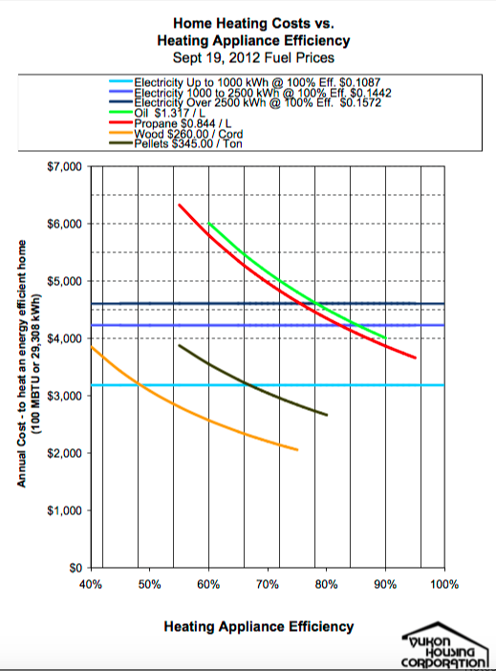
What are utilities all about?
How will you heat the house?
Oil
Propane
Electricity
Wood
You’ll have to pay for electricity too

Slide 14
What about other home costs?
How much is internet if you want to have it at home?
What about TV?
If you own the house, you’ll have to pay city taxes as well as utilities (water/sewer)

Slide 15
Ok- let’s see what’s out there
Find a house for sale or for rent in Whitehorse
Try Kijiji for rentals, and MLS for houses for sale (links on our class webpage)
Choose your option, and fill in the housing sheets in your booklet

